Slide 1


Chapter 1
Understanding Virtualization
Virtualization Essentials

Slide 2
Chapter 1 Objectives
Describe virtualization
Understand the three properties outlined by Popek and Goldberg
Understand the two key trends that drove virtualization
Understand why virtualization is a key technology in the datacenter
2

Slide 3
What Is Virtualization?
Abstracting a resource
The process where physical servers are converted in virtual machines but, to their users, appear and behave as before
A new model of resource utilization
The next application platform infrastructure
3

Slide 4
Virtualization Is Not New
Mainframe virtualization in the 1960s
Codified in 1970s by Popek and Goldberg’s three properties
Fidelity: Virtual environment should be identical to physical
Isolation or Safety: VMM must have control of system resources
Performance: Little or no difference in performance
An efficient VMM has all three properties
4

Slide 5
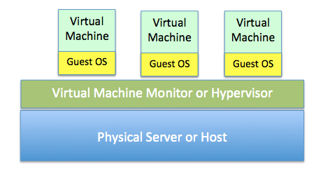
A Virtual Machine Monitor
A VMM is called a hypervisor today
5

Slide 6
The Rise of Windows
Companies began using technology to achieve competitive advantages and save money (1970s)
Proprietary solutions were expensive and inflexible
Windows provided commodity platforms that drove down costs and defeated platform lock-in (1980s)
Windows limitations often forced a “one server, one application” policy
6

Slide 7
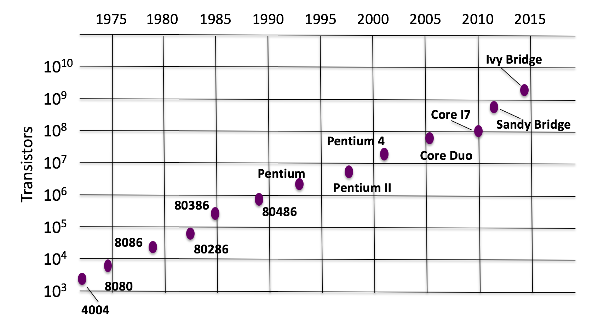
Moore’s Law
Processing power doubles roughly every 18 months
Originally, was coined around processing power (transistor density)
Today applies to many technologies
7

Slide 8
Rapid Datacenter Growth
Windows server growth drove datacenter growth
Datacenter growth drove resource utilization
Power, cooling, cables, square footage, staff, security
Moore’s law made servers more powerful but less efficient because of application deployment practices
8

Slide 9
Trends That Accelerate Virtualization
Consolidation
Running multiple workloads on a single host
Consolidation ratio
Containment
Deploying new applications in a virtual infrastructure
Virtualization first policy
Move from an infrastructure enhancer to business enabler
9

Slide 10
Why Virtualization Matters
Hypervisors allow multiple virtual servers to run on a single host; in this way, fewer servers are used, and resources are consumed more efficiently
Virtualization provides large ROIs by removing cost from the infrastructure
Not just servers, but desktops and applications can be virtualized
First commercial x86 hypervisor developed by VMware in 2001; others soon followed
10

Slide 11
Byte Sizes
Name | Abbreviation | Size
Byte | B | 8 bits (a single character)
Kilobyte | KB | 1,024 B
Megabyte | MB | 1,024 KB
Gigabyte | GB | 1,024 MB
Terabyte | TB | 1,024 GB
Petabyte | PB | 1,024 TB
Exabyte | EB | 1,024 PB
Zettabyte | ZB | 1,024 EB
Yottabyte | YB | 1,024 ZB
11

Slide 12
Chapter 1 Summary
Virtualization optimizes resource usage
Three properties for effective virtualization:
Fidelity, isolation, performance
Moore’s law and the spread of Microsoft Windows
Datacenter virtualization drives down costs, drives better resource efficiencies, and is the platform for the cloud
12

Slide 13
Blogs
Useful sources of how-tos and how-not-tos
Often closer to reality than other sources; not the definitive source
Found this
Some I like:
Scott Lowe, Vaughn Stewart, Chad Sakac, Duncan Epping, Frank Denneman, VMware Blogs, Virtualization Matrix, Virtualization.com
13

